Slide 1
The TOEIC listening and reading test.
Test of english for international communication

Slide 2
What is TOEIC?
TOEIC is a standardized test that measures your listening and reading skills.
It evaluates your ability to function in international business and real-world settings rather than in an academic setting (TOEFL).
The topics and situations are therefore taken from the real world.

Slide 3
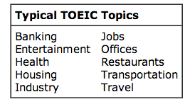

Slide 5
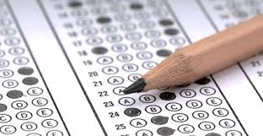
What is it like?
It is a multiple-choice test.

Slide 6
Why take the test?
The test is used by organizations to determine whether an employee is suitable for a particular task.
You may also want to assess your level of English with a standardized international test.
Or you may want to show your result on your CV.

Slide 7
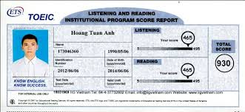
What do I get after?
You will receive a score report like this one (without the photo):
Keep it as you will not receive another one.

Slide 8
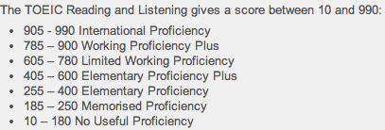
What do the scores mean?

Slide 9
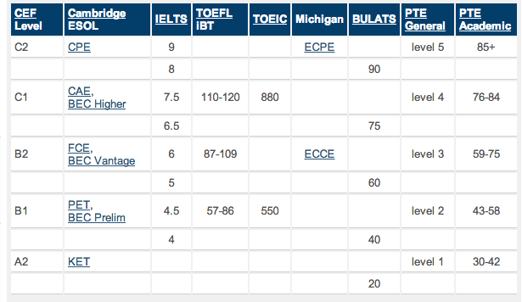
Comparison of CEF (Common European Framework) levels and scores for various exams.

Slide 10
What shall I do to take it?
Register with your teacher (name and email address).
Give a cheque of €44 payable to « comptable du lycée hôtelier de Gascogne » to your teacher before December 12.
Come on Tuesday January 27 at 9:15 (salle des conferences.)
Bring a pencil and an eraser (no pen!).

Slide 11
How can I train?
Log in to http://englishfortourism.e-monsite.com/
and then on the right to the TOEIC section and you will have all the required information
Online: http://www.4tests.com/exams then choose TOEIC.
Or at http://www.examenglish.com/
Or at: http://www.english-test.net/toeic/

